Slide 1



ENVIRONMENT IN HUMANITARIAN ACTION (EHA) TRAINING
Module 3:
Sustainable Waste Management in Humanitarian Contexts
Name of Facilitator:
Venue:
Date:

Slide 2

Module Outline
0
1
0
2
0
3
0
4
Introduction to waste management in humanitarian settings
Practical approaches to waste management
Challenges and strategic solutions in waste management
Case studies and best practices
Notes:
2

Slide 3

0
1
Module Learning Outcomes

Slide 4
By the end of this module, you should be able to:
Identify and understand the different types of waste generated in humanitarian settings and the specific challenges they pose.
Apply the principles of sustainable waste management in various emergency scenarios, ensuring environmental and health protection.
Design effective waste management strategies that minimize environmental impact and enhance the sustainability of humanitarian operations.
Analyze case studies to extract best practices and innovative solutions in waste management from real-world humanitarian contexts.
Engage communities effectively in sustainable waste management practices, recognizing both the social impacts and the importance of community participation.
Address challenges in waste management by developing practical solutions and adapting strategies to overcome obstacles in diverse humanitarian settings
Notes:
4

Slide 5

0
2
Session 1: Introduction to waste management in humanitarian settings

Slide 6
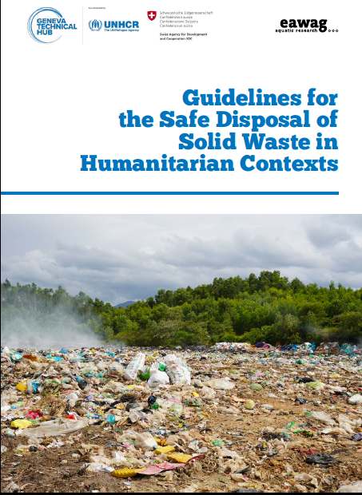
Understanding Waste
  Waste is any material that is discarded, unwanted, or considered worthless.
  Not considered waste: Items reused, recycled, or recovered (e.g., excess food redistributed or repurposed construction materials).
  Rapid influx of people and limited infrastructure lead to waste management challenges.
  Risk of environmental contamination, disease outbreaks, and long-term ecological damage.
  Effective waste management protects the environment and enhances health and well-being.
Source: UNHCR
Notes:
6

Slide 7
WASTE TYPES AND IMPACTS
Solid Waste
  Non-liquid waste from household, commercial, and industrial sources.
  Impacts: Land pollution, water pollution, health hazards, reduced livability, and marine pollution.
  Example: Refugee camps generating significant amounts of plastic waste.
Hazardous Waste
  Toxic, corrosive, or flammable substances posing health and environmental risks.
  Impacts: Environmental contamination, health risks, fire/explosions, long-term ecosystem damage.
  Example: Improper disposal of medical waste in field hospitals.

Slide 8
WASTE TYPES AND IMPACTS
Electronic Waste (E-Waste)
  Discarded electronic devices containing hazardous materials.
  Impacts: Toxic leachate, air pollution, resource misuse, long-term environmental degradation.
  Example: Broken communication devices in conflict zones.
Organic Waste
  Biodegradable waste from food and plant materials.
  Impacts: Methane emissions, disease outbreaks, water contamination, missed opportunities for composting.
  Example: Organic waste from feeding programs in refugee camps.
Construction Debris
  Waste generated from construction, renovation, or demolition.
  Impacts: Physical hazards, habitat destruction, resource depletion, air and water pollution.
  Example: Debris from rebuilding efforts post-disaster.
Notes:
8

Slide 9



Importance of Waste Management in Humanitarian Settings
Environmental Conservation
Resource Efficiency
Health Protection
  Proper waste management prevents the spread of diseases.
  Example: Managing waste to prevent vector-borne diseases like malaria in camps.
  Reduces pollution, conserves resources, and protects ecosystems.
  Example: Implementing waste segregation and recycling in disaster recovery operations.
  Promotes recycling, reuse, and efficient resource use.
  Example: Reusing construction materials in the rebuilding phase post-disaster.

Slide 10
Importance of Waste Management in Humanitarian Settings
Compliance with regulations
Community well-being
Long-term recovery and resilience
  Ensures that waste management practices adhere to local and international environmental laws and standards.
  Example: Aligning waste disposal practices with local environmental laws in post-disaster recovery, particularly in handling hazardous waste like faecal sludge.
  Supports the dignity and well-being of affected populations by maintaining clean and safe living environments.
  Example: Establishing regular waste collection in temporary shelters to improve living conditions, particularly in managing organic waste and faecal matter.
  Facilitates long-term recovery and resilience by promoting sustainable waste management practices that can be maintained post-crisis.
  Example: Integrating waste management into reconstruction efforts to ensure sustainable development, with a focus on proper wastewater management to prevent future contamination.
Notes:
10

Slide 11
Principles of Sustainable Waste Management
Waste minimization: Reducing waste generation.
Waste segregation: Separating waste for appropriate disposal.
Sustainable waste practices enhance the overall success of humanitarian interventions.
Reuse: Reusing items for same or different purposes
Recycling : Extending the lifecycle of materials.
Safe disposal: Ensuring waste disposal minimizes environmental and health risks.
Environmental education: Raising awareness and educating on sustainable practices.
Notes:
11

Slide 12

0
3
Session 2: Practical approaches to waste management

Slide 13
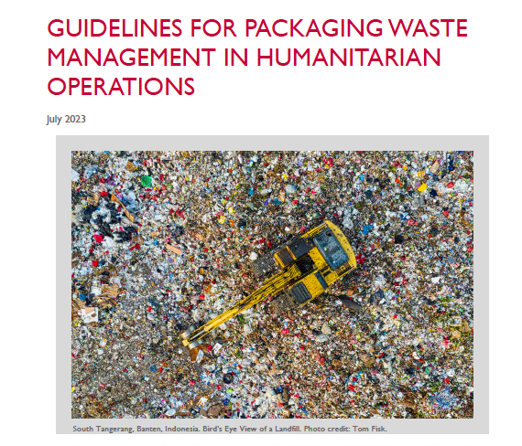
  Effective waste management in humanitarian settings is critical for protecting public health and minimizing environmental impacts.
  Tailored approaches are needed for different contexts based on local conditions, resources, and specific needs.
  Innovative technologies can improve waste management outcomes, especially in resource-constrained environments.
  Waste management should be part of overall response strategies, aligning with shelter, WASH, and health interventions.
Source: Joint Initiative for Sustainable Humanitarian Assistance Packaging Waste Management
Notes:
13

Slide 14
Key Steps in Designing Waste Management Systems
0
1
0
2
0
3
0
4
Assessment of Waste Generation
  Evaluate types and volumes of waste expected in the context.
  Example: Conducting a waste audit in a refugee camp to estimate volumes of organic, plastic, and hazardous waste.
Selection of Appropriate Waste Management Technologies
  Choose suitable technologies considering resources, environmental conditions, and cultural appropriateness.
  Example: Selecting composting toilets for regions with limited water resources.
Implementation and Coordination
  Implement the system, ensuring coordination with other humanitarian activities.
  Example: Coordinating waste collection schedules with food distribution to reduce waste buildup in camps.
Monitoring and Adaptation
  Continuously monitor and adapt waste management based on feedback and changes in conditions.
  Example: Adjusting waste segregation practices in camps to improve compliance and reduce contamination.

Slide 15
Waste Management in Different Humanitarian Contexts
Refugee Camps
      Comprehensive waste segregation, regular collection, and community involvement.
      Recycling initiatives and composting for organic waste.
      Key considerations:
    Cost-effective solutions and integration into camp management.
    Example: Establishing waste segregation stations and using biogas systems to convert organic waste into cooking fuel.
Urban Disaster Areas
      Temporary waste collection points, coordination with local authorities, recycling debris.
      Key considerations:
      Coordination with local authorities and handling hazardous materials.
      Example: Recycling construction debris from damaged buildings and deploying teams to handle hazardous waste.

Slide 16
Waste Management in Different Humanitarian Contexts
Remote Rural Locations
      On-site low-tech solutions, composting, sealed pits for faecal matter.
      Community-driven waste management practices.
      Key considerations:
      Limited infrastructure and need for innovative, low-tech solutions.
      Example: Composting toilets and community-led waste-to-energy projects.
Conflict Zones
      Secure hazardous waste, mobile treatment units, portable sanitation facilities.
      Key considerations:
      Security risks, mobile units, and remote monitoring.
      Example: Mobile waste treatment units deployed in conflict zones to manage hazardous waste.

Slide 17
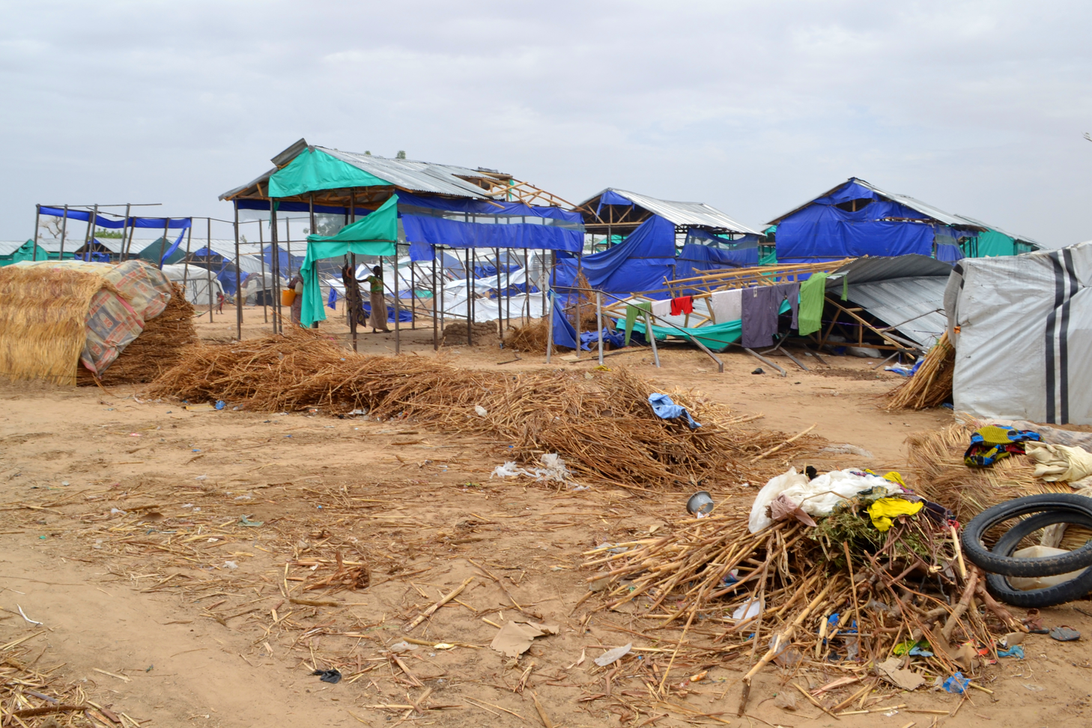
Waste Management in Different Humanitarian Contexts
Temporary Shelters
      Portable sanitation solutions, regular waste removal, recycling.
      Space-saving waste management technologies.
Key considerations:
      Limited space and resources, rapid setup, hygiene maintenance.
      Example: Portable toilets and waste compactors used in shelters to maintain hygiene.
Source: OCHA
Notes:
17

Slide 18
Innovative Solutions and Technologies
  Compacts waste using solar energy, reducing waste volume and collection frequency.
  Lowers transportation costs and is energy-efficient.
  Example: Solar-powered compactors deployed in refugee camps in Kenya.
Solar-powered Waste Compactors
  Converts non-recyclable plastic into bricks for construction by packing plastic into bottles.
  Reduces environmental pollution and provides building materials.
  Example: Eco-bricks used in disaster recovery projects in the Philippines to build schools and community centers.
Eco-bricks
Notes:
18

Slide 19
Innovative Solutions and Technologies
  Converts organic waste into biogas for cooking or electricity.
  Provides renewable energy, reduces organic waste, minimizes deforestation.
  Example: Biogas systems installed in refugee camps in Rwanda, converting food waste into cooking fuel.
Biogas Systems
  Portable units treat waste on-site, especially hazardous waste.
  Immediate waste treatment, reduces environmental risks.
  Example: Mobile waste treatment units used in Yemen to manage hazardous waste from medical facilities.
Mobile Waste Treatment Units
  Sanitation solutions that don’t require water, using chemical or biological processes.
  Ideal for water-scarce environments, reduces water contamination risk.
  Example: Waterless toilets used in drought-affected regions of Ethiopia to reduce strain on water resources.
Waterless Toilets
Notes:
19

Slide 20
Innovative technologies like solar-powered compactors and biogas systems enhance waste management sustainability.
Practical approaches in humanitarian contexts depend on local conditions and available resources.
Tailored waste management strategies improve public health, reduce environmental impact, and ensure long-term resilience.

Slide 21

0
4
Session 3: Challenges and strategic solutions in waste management

Slide 22

Challenges in Humanitarian Waste Management
  Waste management faces logistical, resource, and cultural challenges.
  Ineffective waste management can exacerbate environmental degradation and health risks.
  Addressing waste management challenges requires innovation, coordination among stakeholders, and integration of sustainable practices into humanitarian operations.

Slide 23
KEY CHALLENGES
Logistical Constraints
Difficulty in transporting waste due to damaged infrastructure or remote locations.
Solutions:
  Use of mobile waste treatment units.
  Establish temporary waste collection points.
  Coordinate with local authorities for waste management.
    Example: Deploying mobile incinerators in disaster-affected areas to manage hazardous medical waste.
Limited Resources
Lack of financial resources, materials, and trained personnel for waste management.
Solutions:
    Seek partnerships with local NGOs and international organizations.
    Train local communities in basic waste management techniques.
    Utilize low-cost, low-tech solutions.
    Example: Partnering with NGOs to manage waste in urban disaster areas.

Slide 24
Key Challenges
Cultural and social barriers
Resistance to new waste management practices due to cultural beliefs or lack of awareness.
Solutions:
    Engage in community education and awareness campaigns.
    Incorporate local customs into waste management plans.
    Involve community leaders in decision-making.
    Example: Conducting waste management workshops that respect local customs in conflict zones.
Security risks in conflict zones
Managing waste in conflict zones can be dangerous for workers.
Solutions:
    Implement remote waste monitoring and management.
    Coordinate with security forces for safe access to waste sites.
    Use mobile units.
    Example: Using remote monitoring technology to oversee waste management in conflict areas.

Slide 25
Key Challenges
Environmental hazards
Risk of contamination due to improper disposal, especially hazardous or medical waste.
Solutions:
    Establish specialized disposal facilities for hazardous waste.
  Implement strict waste segregation and disposal protocols.
    Conduct regular environmental monitoring.
    Example: Creating specialized hazardous waste disposal sites near healthcare facilities.
Regulatory compliance
Difficulty adhering to local, national, and international regulations in emergency settings.
Solutions:
    Conduct regular legal reviews for compliance.
    Coordinate with local authorities to align practices with legal requirements.
    Adapt protocols to local laws.
    Example: Working with local governments to ensure compliance with national regulations during disaster recovery.

Slide 26
Key Challenges
Climate change impacts
Disasters increase waste generation, complicating management.
Solutions:
    Integrate climate-resilient waste management practices.
    Plan for increased waste volumes during climate-related events.
    Enhance infrastructure to withstand extreme weather.
    Example: Developing waste management plans for flood-prone areas, accounting for increased waste during disasters.
Multiple tools and frameworks
Confusion due to numerous waste management tools and inconsistent application.
Solutions:
    Develop clear guidelines for tool selection based on context.
    Provide training on various tools.
    Simplify toolkits for broader application.
    Example: Training on the NEAT+ tool for environmental assessments in humanitarian settings.

Slide 27
Key Challenges
Coordination among stakeholders
Difficulty coordinating waste management among governments, NGOs, and local communities.
Solutions:
    Establish clear roles and responsibilities.
    Facilitate regular communication among stakeholders.
    Use centralized management systems.
    Example: Setting up coordination committees in large refugee camps to streamline waste management efforts.

Slide 28
Social Impacts of Waste Management
Positive social impacts
Effective waste management improves public health, creates jobs, and enhances community cohesion.
Solutions:
      Engage communities in waste management processes.
      Promote waste-to-resource initiatives (recycling, composting).
      Example: Creating employment opportunities through community-based recycling programs in refugee camps.
Negative social impacts
Poorly managed waste can lead to social tensions, health hazards, and marginalization of vulnerable groups.
Solutions:
      Implement culturally appropriate waste management practices.
      Involve community leaders in decision-making.
      Example: Addressing community concerns about waste disposal locations that negatively impact marginalized groups.
Community Engagement and Participation
Lack of community involvement often leads to failure of waste management initiatives.
Solutions:
    Conduct regular community consultations and participatory planning.
    Develop culturally relevant educational campaigns on waste management.
    Example: Involving local communities in the design and implementation of waste management strategies in disaster areas.

Slide 29
Successful waste management strategies require innovative solutions, stakeholder coordination, and community involvement.
Practical solutions like mobile treatment units, training, and climate-resilient practices help address these challenges.

Slide 30

0
5
Session 4: Case studies and best practices

Slide 31
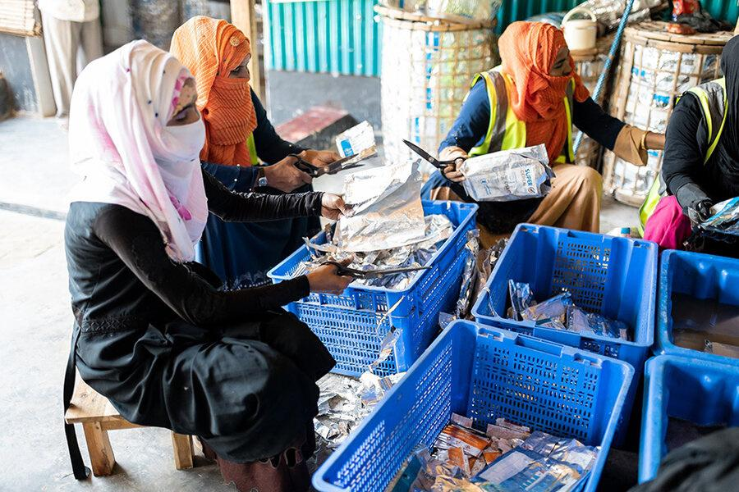
Case Study: Upcycling in Cox’s Bazar
  Context: Large influx of Rohingya refugees.
  Environmental Challenge: Managing large volumes of waste generated in camps and providing sustainable employment.
  Humanitarian Response: WFP set up an upcycling center to transform packaging waste into useful products and cleared 80km of canals to prevent flood risks.
  Lessons Learned: Upcycling waste reduces pollution, promotes sustainability, and empowers women by providing work opportunities.
Source: WFP
Notes:
31

Slide 32
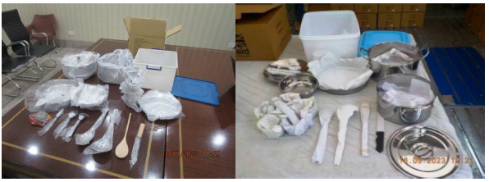
Case Study: Managing Packaging Waste in Humanitarian Operations
  Context: HSOT, UK’s humanitarian and stabilization operations.
  Environmental Challenge: Pollution from single-use plastic packaging in aid deliveries.
  Humanitarian Response: HSOT eliminated single-use plastics, replaced them with sustainable options, and ensured recycled packaging.
  Lessons Learned: Supplier collaboration and regulatory compliance (e.g., UK Plastic Packaging Tax) are essential for promoting sustainable practices.
Source: Palladium/FCDO
Notes:
32

Slide 33
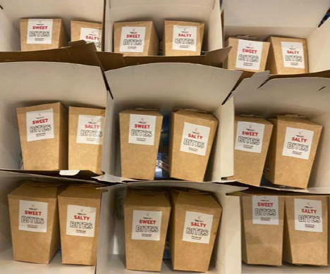
Case Study: ACTED Lebanon’s Holistic Approach
  Context: Response to Lebanon’s waste crisis.
  Environmental Challenge: Low waste management capacity and high carbon footprint.
  Humanitarian Response: ACTED introduced sustainable procurement, banned single-use plastics, launched recycling, and influenced suppliers.
  Lessons Learned: Organizational change requires leadership, staff buy-in, and strategic partnerships. Small changes can lead to significant environmental impact.
Source: Joint Initiative
Notes:
33

Slide 34

Case Study: Sustainable Waste Management in Logistics (IFRC)
  Context: IFRC’s humanitarian logistics operations.
  Environmental Challenge: Excessive waste generation, particularly from packaging.
  Humanitarian Response: IFRC removed single-use plastics, adopted sustainable materials, and encouraged greener supplier practices.
  Lessons Learned: Sustainable packaging reduces environmental impact, improves waste management, and can lead to cost savings.
Source: IFRC
Notes:
34

Slide 35



Case Study: Compost Toilets in Refugee Camps
  Context: Refugee camps in Kenya (Kakuma) and Uganda (Nakivale).
  Environmental Challenge: Poor sanitation and lack of sustainable waste management solutions.
  Humanitarian Response: Treebog compost toilets in Kakuma and EcoSan toilets in Nakivale provided sustainable sanitation and compost for agriculture.
  Lessons Learned: Compost toilets enhance food security and environmental health. Community involvement is key for acceptance and long-term use.
Source: Re-Alliance
Notes:
35

Slide 36
Key Takeaways
Effective waste management prevents health hazards, environmental degradation, and social disruption.
Addressing solid, hazardous, and faecal waste is crucial for maintaining safe conditions.
Waste minimization, segregation, recycling, and safe disposal reduce environmental footprints and protect public health.
Technologies like eco-bricks, biogas systems, and mobile waste treatment units offer practical, sustainable approaches in resource-constrained settings.
Involving local populations in decision-making enhances waste management systems’ acceptance, ownership, and success.
Logistical constraints, limited resources, and security risks require innovative solutions, stakeholder coordination, and adaptive approaches.
Proper waste management reduces disease spread, environmental pollution, and supports overall community well-being.
Tailor waste management strategies to specific humanitarian scenarios, such as camps, urban areas, and rural locations.
Success stories like faecal sludge management in Bangladesh and upcycling in Cox’s Bazar demonstrate the power of innovation and community involvement.
Waste management must align with broader humanitarian interventions, like health, WASH, and shelter, to maximize resource efficiency.

Slide 37
Thank you
Any Questions?

