Slide 1



ENVIRONMENT IN HUMANITARIAN ACTION (EHA) TRAINING
Module 6:
Sustainable Land Management in Humanitarian Action
Name of Facilitator:
Venue:
Date:

Slide 2


Module Outline
0
1
0
2
0
3
0
4
Introduction to sustainable land management in humanitarian action
Causes and impacts of unsustainable land management
Sustainable land management and habitat restoration practices
Case studies and best practices
Notes:
2

Slide 3

0
1
Module Learning Outcomes

Slide 4
By the end of this module, you should be able to:
Understand key concepts of sustainable land management in humanitarian contexts.
Identify the causes and impacts of unsustainable land management in humanitarian settings.
Develop strategies for sustainable land management and habitat restoration.
Apply best practices for mitigating land degradation and restoring disrupted habitats.
Create land management plans tailored to humanitarian scenarios
Notes:
4

Slide 5

0
2
Session 1: Introduction to sustainable land management in humanitarian action

Slide 6

  Sustainable land management ensures natural resources for survival and recovery are preserved.
  Prevents land degradation, supports livelihoods, and reduces vulnerability to natural disasters.
  Contributes to health, well-being, and long-term resilience of affected populations.
  Example: Implementing sustainable land practices in refugee camps to prevent soil erosion and reduce deforestation impacts.
Sustainable Land Management - Why It Matters

Slide 7




Key Concepts
Sustainable Land Management: Strategies for efficient use and conservation of land resources.
Example: Applying soil conservation practices in displaced areas to prevent degradation and ensure land productivity.
Habitat Restoration: Restoring degraded habitats to their natural state.
Example: Conducting reforestation and soil restoration programs in deforested crisis-affected areas.
Deforestation: Clearing forests, leading to biodiversity loss and ecosystem disruption.
Example: Deforestation for refugee camps leading to habitat loss and increased carbon emissions.
Reforestation: Planting trees to restore forests in areas that have been deforested.
Example: Replanting trees in deforested areas of refugee camps to restore the environment and provide fuel sources.

Slide 8




Key Concepts
Afforestation: Planting trees in areas that were not previously forested.
Example: Creating new forests near humanitarian camps to combat desertification and improve local climate conditions.
Land Degradation: Decline in land quality due to improper practices, reducing productivity.
Example: Overgrazing near camps causing soil erosion and loss of agricultural productivity.
Habitat Disruption: Disturbance of habitats due to human activities such as construction.
Example: Habitat loss caused by construction of temporary shelters in crisis zones.
Acceptable Damage: Balancing immediate humanitarian needs with long-term sustainability.
Example: Allowing temporary land use changes in emergency settings while planning for future restoration.

Slide 9


Importance of Sustainable Land Management in Humanitarian Action
Prevention of Environmental Degradation: Preserves ecosystems critical for survival.
Support for Livelihoods & Food Security: Ensures continued agricultural productivity and resource availability.
Reduction of Vulnerability to Disasters: Practices like reforestation reduce risks of floods and landslides.
Example: Sustainable land practices in refugee camps prevent deforestation, reducing soil erosion and preserving water quality.
Example: Sustainable farming techniques introduced in drought-prone areas to increase food security and resilience.
Example: Reforestation in post-crisis areas to prevent landslides and flooding during the rainy season.

Slide 10



Importance of Sustainable Land Management in Humanitarian Action
Promotion of Long-term Recovery: Healthy ecosystems aid in recovery and rebuilding after crises.
Human Health & Well-being: Ecosystems provide clean air, water, and food, improving health.
Resource Efficiency & Waste Reduction: Optimizes resource use, crucial in crises where resources are scarce.
Example: Soil restoration projects improve the resilience of agricultural lands post-crisis, promoting sustainable recovery.
Example: Reforestation projects in refugee camps ensure access to clean air and reduce risks from air pollution.
Example: Water-efficient land management in camps, such as rainwater harvesting, to conserve scarce water resources.

Slide 11


Importance of Sustainable Land Management in Humanitarian Action
Climate Change Mitigation & Adaptation: Sequesters carbon and helps communities adapt to climate impacts.
Community Involvement: Engages local communities, ensuring sustainability and building local capacity.
Protection of Water Resources: Efficient water management ensures an adequate supply for health and agriculture.
Example: Reforestation to sequester carbon and mitigate local climate impacts in disaster-prone regions.
Example: Community-led soil conservation and reforestation projects in crisis areas ensure ownership and long-term success.
Example: Implementing soil and water conservation practices to protect water sources in drought-prone areas.

Slide 12

Session 2: Causes and impacts of unsustainable land management
0
3

Slide 13
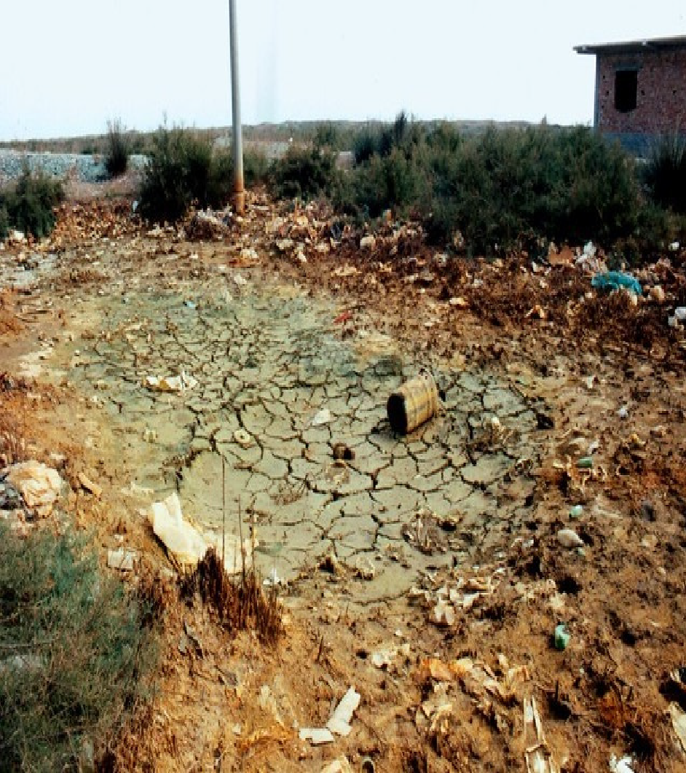
Overview of Unsustainable Land Management in Humanitarian Contexts
Humanitarian operations often lead to unsustainable land management due to the urgent need for resources, shelter, and food production.
Activities such as resource overexploitation, agricultural expansion, and conflict-related damage contribute to environmental degradation.
Climate change exacerbates these challenges, stressing vulnerable ecosystems and increasing the frequency of natural disasters.
Source: UNEP

Slide 14



Overview of Unsustainable Land Management in Humanitarian Contexts
Humanitarian operations often lead to unsustainable land management due to the urgent need for resources, shelter, and food production.
Activities such as resource overexploitation, agricultural expansion, and conflict-related damage contribute to environmental degradation.
Climate change exacerbates these challenges, stressing vulnerable ecosystems and increasing the frequency of natural disasters.

Slide 15



Causes of Unsustainable Land Management
Disturbance of ecosystems through human activities like construction, pollution, and temporary settlements.
Impacts: Loss of species, disrupted ecosystem functions, and reduced resilience to environmental changes.
Example: Construction of temporary shelters in forest regions causing habitat fragmentation and species loss.
Habitat Disruption:
Unsustainable extraction of resources such as timber, water, and minerals in crisis contexts.
Impacts: Depletion of resources, biodiversity loss, and environmental degradation.
Example: Excessive logging for building materials in IDP camps leading to deforestation and habitat loss.
Overexploitation of Resources:
Land use changes due to the presence of landmines, explosives, and remnants of war.
Impacts: Land contamination, delays in land restoration, and threats to human life and biodiversity.
Example: Post-conflict regions where landmines prevent agricultural rehabilitation.
Conflict-Related Activities:
Notes:
15

Slide 16
Causes of Unsustainable Land Management
Notes:
16

Slide 17



Causes of Unsustainable Land Management
Conversion of forests and natural landscapes into agricultural lands to support displaced populations.
Impacts: Deforestation, soil degradation, habitat loss, and increased greenhouse gas emissions.
Example: Clearing forests for agricultural projects in refugee camps, leading to habitat destruction.
Agricultural Expansion:
Harmful agricultural practices such as excessive pesticide use and over-irrigation.
Impacts: Soil degradation, water pollution, and reduced productivity.
Example: Over-irrigation in refugee camp agriculture leading to soil salinization and reduced crop yields.
Unsustainable Agriculture:
Expansion of urban settlements into natural habitats for displaced populations.
Impacts: Habitat fragmentation, pollution, and reduced biodiversity.
Example: Building settlements for displaced communities in urban areas, causing habitat destruction.
Urbanization:
Notes:
17

Slide 18


Causes of Unsustainable Land Management
Infrastructure Development:
Construction of roads, buildings, and facilities in crisis areas.
Impacts: Deforestation, habitat disruption, soil erosion, and pollution.
Example: Road construction in disaster zones disrupting local ecosystems and causing soil erosion.
Climate changes exacerbating vulnerabilities of ecosystems, leading to resource stress.
Impacts: More frequent natural disasters, altered ecosystems, and further land degradation.
Example: Rising temperatures and erratic rainfall patterns increasing soil erosion in displaced populations' regions.
Climate Change:
Pollution and land degradation from makeshift industrial processes in crisis situations.
Impacts: Contamination of soil and water, biodiversity loss, and health hazards.
Example: Oil spills in conflict zones contaminating land and water sources, affecting both human and ecological health.
Industrial Activities:
Notes:
18

Slide 19

0
4
Session 3: Sustainable land management and habitat restoration practices

Slide 20


OVERVIEW
Sustainable land management mitigates the environmental footprint of humanitarian operations.
Habitat restoration enhances biodiversity and ecosystem services, supporting both the environment and local communities.
Community involvement ensures the sustainability and effectiveness of these practices.

Slide 21
Sustainable Land Management and Restoration
Climate-Resilient Land Management
  Incorporating climate predictions and selecting climate-resistant crops for land use.
  Importance: Mitigates the impacts of climate change, ensuring resource sustainability.
  Example: Using drought-resistant crops and creating green spaces in drought-prone areas of humanitarian settlements.
Land Management Techniques
  Methods to sustainably use and conserve land resources.
  Importance: Promotes long-term sustainability and resilience of land.
  Example: Implementing agroforestry and soil conservation in refugee camps to prevent soil erosion and maintain food production.

Slide 22
Sustainable Land Management and Restoration
Community Involvement
  Engaging local communities in land management and restoration projects.
  Importance: Ensures the sustainability and success of restoration initiatives.
  Example: Involving communities in reforestation projects and educating them on sustainable land practices.
Habitat Restoration Techniques
  Techniques like reforestation and soil rehabilitation to restore degraded habitats.
  Importance: Enhances ecosystem services and biodiversity.
  Example: Replanting native trees and restoring wetlands in areas impacted by deforestation and human settlements.

Slide 23
Sustainable Land Management and Restoration
Soil Conservation
  Techniques to prevent soil erosion and degradation.
  Importance: Preserves soil fertility and supports sustainable agriculture.
  Example: Utilizing terracing and no-till farming to maintain soil structure in displaced populations' areas.
Agroforestry
  Integrating trees into agricultural landscapes to improve land productivity and biodiversity.
  Importance: Enhances soil quality and provides additional food and income.
  Example: Planting fruit trees in refugee camp agriculture for food security and soil protection.

Slide 24
Sustainable Land Management and Restoration
Reforestation and Afforestation
  Planting trees to restore deforested areas and create new forests.
  Importance: Enhances biodiversity, carbon sequestration, and ecosystem services.
  Example: Replanting trees in areas impacted by temporary shelters to reduce environmental degradation.
Soil Restoration
  Techniques like erosion control and organic farming to restore soil health.
  Importance: Prevents further degradation and enhances agricultural productivity.
  Example: Soil rehabilitation projects in overgrazed areas to restore fertility and improve food security.

Slide 25
Sustainable Land Management and Restoration
Integrated Pest Management (IPM)
  Using biological, cultural, and mechanical methods to manage pests.
  Importance: Reduces pesticide use, protects ecosystems, and improves food security.
  Example: Using organic mulches and beneficial insects to manage pests in humanitarian agricultural projects.
Green Infrastructure
  Incorporating natural systems into urban planning to manage environmental challenges.
  Importance: Reduces heat islands, manages stormwater, and improves urban biodiversity.
  Example: Developing green roofs and urban parks in disaster-affected urban areas.

Slide 26

0
5
Session 4: Case studies and best practices

Slide 27

Conflict-Caused Deforestation in Syria
  Context: Conflict-induced deforestation due to the need for firewood, charcoal production, and military operations.
  Challenge: Severe deforestation affecting both communities and the environment.
  Humanitarian Response: Reforestation programs, community involvement, and sustainable land management practices.
  Lessons Learned: Importance of community involvement and continuous monitoring; Integration of traditional and modern restoration practices; Effectiveness of protective policies.
Source: PAX
Notes:
27

Slide 28
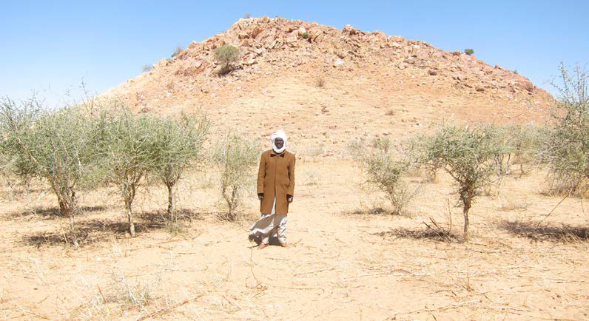
Community-Based Natural Resource Management in Eastern Chad
  Context: Displacement of populations leading to deforestation and land degradation due to resource overexploitation.
  Challenge: Depletion of agricultural land and trees used for fuel and shelter construction.
  Humanitarian Response: Assisted Natural Regeneration (ANR) techniques and community-based reforestation operations supported by DG-ECHO and UNHCR.
  Lessons Learned: Community involvement and local agreements are essential for sustainability; Low-cost, replicable restoration methods are highly effective.
Source: DG ECHO
Notes:
28

Slide 29
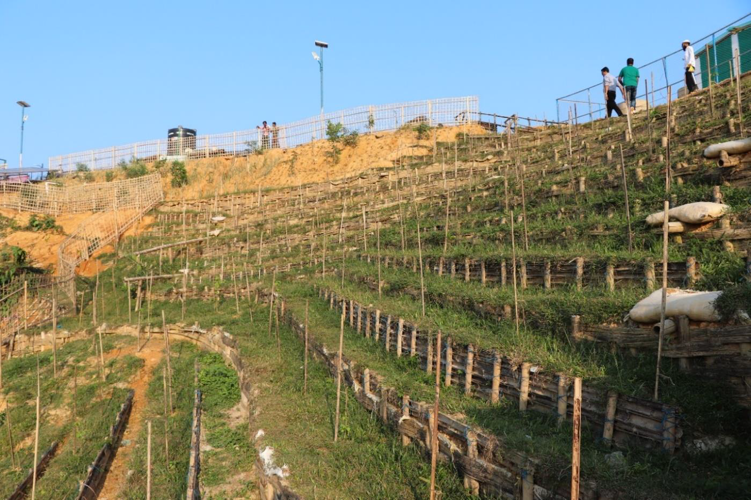
Land Restoration in Rohingya Refugee Camps, Cox’s Bazar, Bangladesh
  Context: Over 7,000 hectares of forest land degraded due to deforestation and settlement activities following the Rohingya refugee influx.
  Challenge: Land degradation leading to disaster risks like landslides and flash floods, and conflicts over natural resources.
  Humanitarian Response: Land restoration programs led by FAO with collaboration from UN agencies, local communities, and the Bangladesh Forest Department. Involvement of refugees in restoration and management activities.
  Lessons Learned: Stakeholder collaboration and community involvement are critical; Use of remote sensing and geospatial tools improves monitoring and planning; Integration of traditional and modern practices ensures sustainability.
Source: FAO
Notes:
29

Slide 30
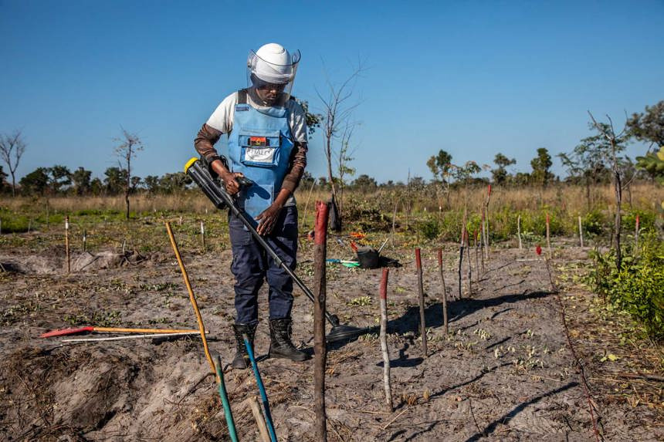
Landmine Clearance and Conservation in the Okavango, Angola
  Context: The Okavango River Basin is heavily mined due to Angola’s 27-year civil war, hindering conservation and restoration efforts.
  Challenge: Landmines pose a lethal threat to both the environment and local communities, obstructing restoration and conservation activities.
  Humanitarian Response: The HALO Trust conducted landmine clearance, enabling habitat restoration and biodiversity conservation in the region.
  Lessons Learned: Landmine clearance is essential for safe restoration; Engaging local communities enhances sustainability; Combining conservation and landmine clearance maximizes the impact of both initiatives.
Source: The HALO Trust
Notes:
30

Slide 31
Key Takeaways
Sustainable land management prevents environmental degradation, supports livelihoods, and builds resilience in crisis-affected areas.
Causes of land degradation include deforestation, overexploitation, conflict, unsustainable agriculture, and urbanization, leading to habitat loss and soil erosion.
Restoration techniques like reforestation, agroforestry, and soil conservation help recover ecosystems and protect resources.
Community involvement ensures sustainable interventions and integrates local knowledge with modern practices.
Balancing humanitarian needs and sustainability minimizes the environmental impact of operations and promotes resilience.
Case studies from Syria, Chad, Bangladesh, and Angola show the value of collaboration, local knowledge, and continuous monitoring.
Conflict and climate change increase land degradation, requiring innovative, climate-resilient solutions.
Integrating sustainable land management into humanitarian programs is essential for long-term environmental and community resilience.
Notes:
31

Slide 32
Thank you
Any Questions?

