Slide 1



ENVIRONMENT IN HUMANITARIAN ACTION (EHA) TRAINING
Module 7:
Greenhouse Gas Emissions Reduction and Sustainable Energy Management
Name of Facilitator:
Venue:
Date:

Slide 2

Module Outline
0
1
0
2
0
3
0
4
Introduction to greenhouse gas emissions and sustainable energy management in humanitarian operations
Sources and impacts of greenhouse gas emissions
Strategies for reducing emissions
Case studies and best practices
Notes:
2

Slide 3

0
1
Module Learning Outcomes

Slide 4
By the end of this module, you should be able to:
Identify and classify sources of greenhouse gas emissions in humanitarian operations.
Analyze the environmental and humanitarian impacts of GHG emissions within the context of humanitarian operations.
Develop and implement strategies for reducing emissions and promoting renewable energy.
Understand the importance of sustainable energy management and its role in reducing the environmental impact of humanitarian actions.
Notes:
4

Slide 5

Session 1: Introduction to greenhouse gas emissions and sustainable energy management in humanitarian operations
0
2

Slide 6
Introduction
Managing GHG emissions is crucial for minimizing the environmental footprint of humanitarian operations and mitigating climate change.
Sustainable energy management focuses on using renewable energy sources and energy-efficient practices to reduce operational costs and enhance resilience.
Alignment with global environmental goals, such as the Paris Agreement and SDGs, enhances the sustainability of humanitarian operations.
Sustainable energy solutions reduce the dependency on non-renewable resources and enhance the resilience of communities by providing reliable, eco-friendly energy.

Slide 7
Key Concepts
Greenhouse gas (GHG) emissions: Gases like CO2, methane, and nitrous oxide that trap heat in the atmosphere.
  Example: Transitioning to energy-efficient technologies in field operations reduces emissions from diesel generators in humanitarian contexts.
Sustainable energy management: The strategic use of energy resources to reduce environmental impact and operational costs.
  Example: Deploying renewable energy sources such as wind and solar power in disaster zones reduces the need for costly and polluting fuel supplies.
Carbon footprint: The total GHG emissions associated with an organization's operations, expressed as carbon dioxide equivalent (CO2e).
  Example: Measuring the carbon footprint of humanitarian logistics and supply chains helps identify areas for emission reductions, such as optimizing transport routes.
Renewable energy: Energy from natural sources such as solar, wind, and bioenergy that are constantly replenished.
  Example: Solar panels used to provide energy in remote refugee camps offer a sustainable alternative to non-renewable energy sources.

Slide 8
Key Concepts – Greenhouse Gases Emissions
Scope 1 (Direct emissions): Emissions from sources directly controlled by the organization (vehicles, generators).
Example: Using electric or hybrid vehicles instead of diesel vehicles for transportation in field operations reduces direct emissions.
Scope 2 (Indirect emissions): Emissions from purchased electricity, heating, and cooling used by the organization.
Example: Installing solar panels at humanitarian field offices reduces reliance on fossil fuels for electricity generation.
Scope 3 (Other indirect emissions): Emissions from the entire value chain, including procurement, travel, and waste management.
Example: Local sourcing of materials reduces transportation emissions, contributing to lower Scope 3 emissions in humanitarian operations.

Slide 9



Importance of Sustainable Energy Management
Minimizing environmental impact: Reduces GHG emissions and reliance on fossil fuels.
Example: Solar panels installed in refugee camps significantly lower carbon emissions compared to traditional diesel generators.
Cost efficiency: Reduces long-term operational costs, particularly in remote or off-grid locations.
Example: Energy-efficient lighting and solar energy systems reduce fuel and energy expenses in disaster relief operations.
Resilience and reliability: Sustainable energy sources provide reliable energy in areas where traditional energy supply may be disrupted.
Example: Solar-powered water pumps in drought-prone regions provide a consistent water supply even during fuel shortages.

Slide 10



Importance of Sustainable Energy Management
Supporting long-term sustainability: Reduces dependency on non-renewable resources, enhancing the long-term viability of humanitarian operations.
Example: Implementing microgrid systems in disaster-affected areas provides a scalable and sustainable energy solution.
Alignment with global goals: Contributes to international agreements like the Paris Agreement and SDGs.
Example: Integrating renewable energy solutions in humanitarian operations supports SDG 13 (Climate Action).
Enhancing community resilience: Sustainable energy solutions build local capacity and reduce dependency on external resources.
Example: Training local communities to maintain solar installations fosters energy independence and resilience.
Reducing operational risks: Decreases reliance on volatile fuel supply chains and reduces security risks associated with fuel transportation in conflict zones.
Example: Transitioning from diesel generators to solar energy reduces the need for fuel convoys, minimizing security risks in conflict-affected areas.

Slide 11

0
3
Session 2: Sources and impacts of greenhouse gas emissions

Slide 12
INTRODUCTION
Understanding GHG emission sources helps humanitarian organizations create effective reduction strategies.
Humanitarian operations contribute to significant GHG emissions, affecting the environment and human health.
Notes:
12

Slide 13
Classification of GHG Emission Sources in Humanitarian Contexts
Scope 1: Direct Emissions
Transportation: Emissions from vehicles and machinery owned or controlled by the organization.
    Example: Trucks delivering aid supplies and ambulances used in disaster areas release CO2 and other pollutants.
On-site Fuel Combustion: Emissions from generators, stoves, and incinerators.
    Example: Diesel generators powering refugee camps emit large amounts of CO2 and particulate matter.
Refrigeration and Air Conditioning: Emissions from refrigerants used in cooling systems.
    Example: Refrigeration units in medical storage facilities for vaccines and air conditioners in field hospitals can leak high-global warming potential gases.
Notes:
13

Slide 14
Classification of GHG Emission Sources in Humanitarian Contexts
Scope 2: Indirect Emissions from Energy Use
Purchased Electricity: Emissions from electricity used by the organization but generated elsewhere.
    Example: Field offices powered by grids reliant on fossil fuels contribute to indirect GHG emissions.
District Heating/Cooling Systems: Emissions from heating or cooling systems purchased by the organization and shared across buildings.
    Example: District heating systems in refugee camps during winter months, powered by fossil fuels, increase GHG emissions.
Notes:
14

Slide 15
Classification of GHG Emission Sources in Humanitarian Contexts
Scope 3: Other Indirect Emissions
Supply Chain Activities: Emissions from the production, transport, and disposal of goods used by the organization.
Waste Management: Emissions from waste disposal, including landfills and incineration.
Procurement of Services: Emissions from contracted services, including construction and catering.
Employee Commuting: Emissions from staff commuting using cars, buses, or other means of transport.
Water Usage and Treatment: Emissions from the sourcing, distribution, and treatment of water used in humanitarian operations.
Travel and Logistics: Emissions from flights and transportation not owned by the organization.
Example: Manufacturing and shipping relief items such as tents and medical supplies increase the carbon footprint.
Example: Flights taken by humanitarian workers for field assessments contribute to significant carbon emissions.
Example: Organic waste in landfills emits methane, and medical waste incineration releases CO2 in refugee camps.
Example: Building shelters and medical facilities using outsourced construction services leads to additional emissions.
Example: Staff commuting by car to field offices contributes to GHG emissions, especially in areas with limited public transport.
Example: Diesel-powered water pumps in refugee camps and energy-intensive water treatment systems contribute to GHG emissions.
Notes:
15

Slide 16


Environmental and Humanitarian Impacts of GHG Emissions
On-site Fuel Combustion
  Environmental Impact: Releases particulate matter, CO2, and other pollutants.
  Humanitarian Impact: Dependence on fuel increases operational costs and health risks from air pollution.
Transportation
  Environmental Impact: Increases CO2 levels, worsens air pollution, and accelerates climate change.
  Humanitarian Impact: Poor air quality affects respiratory health among vulnerable populations.
Notes:
16

Slide 17


Environmental and Humanitarian Impacts of GHG Emissions
Purchased Electricity
  Environmental Impact: Indirect emissions from fossil-fuel-based grids.
  Humanitarian Impact: Reliance on non-renewable energy increases costs and vulnerability to disruptions.
Refrigeration and Air Conditioning
  Environmental Impact: Leaks of refrigerants with high global warming potential.
  Humanitarian Impact: Necessary for medical supplies but can contribute significantly to emissions.
Notes:
17

Slide 18


Environmental and Humanitarian Impacts of GHG Emissions
Travel and Logistics
  Environmental Impact: Air travel contributes significantly to GHG emissions.
  Humanitarian Impact: Travel-related emissions can undermine the sustainability of humanitarian operations.
Supply Chain Activities
  Environmental Impact: Adds to global GHG levels due to production and transportation.
  Humanitarian Impact: Increases the carbon footprint of operations and logistical expenses.
Notes:
18

Slide 19


Environmental and Humanitarian Impacts of GHG Emissions
Procurement of Services
  Environmental Impact: Emissions from construction and material production.
  Humanitarian Impact: Construction activities contribute to environmental degradation and increased costs.
Waste Management
  Environmental Impact: Methane from landfills and CO2 from incineration contribute to climate change.
  Humanitarian Impact: Poor waste management increases health risks and environmental degradation.
Notes:
19

Slide 20


Environmental and Humanitarian Impacts of GHG Emissions
Water Usage and Treatment
    Environmental Impact: Energy-intensive water sourcing and treatment contribute to GHG emissions.
    Humanitarian Impact: Poor water management affects sanitation and increases disease risks.
Employee Commuting
  Environmental Impact: Daily transportation increases CO2 emissions.
  Humanitarian Impact: Air pollution and traffic congestion affect the health of staff and local populations.
Notes:
20

Slide 21

0
4
Session 3: Strategies for reducing emissions

Slide 22

Introduction
  Reducing GHG emissions is critical to minimizing environmental impacts in humanitarian operations.
  Renewable energy provides significant opportunities to lower operational costs, reduce reliance on fossil fuels, and ensure reliable energy in crisis-affected areas.
  Prioritizing key measures such as energy efficiency, procurement, and reducing business air travel can make a substantial impact on reducing carbon footprints in humanitarian efforts.

Slide 23
Key Strategies for Reducing Emissions
Energy-Efficient Techniques:
    Implement energy-saving practices (e.g., LED lighting, better insulation).
    Reduces overall energy consumption and environmental impact.
    Example: Using energy-efficient generators in camps to cut fuel consumption.
Renewable Energy Options:
    Deploy solar, wind, or bioenergy solutions.
    Lowers reliance on fossil fuels and provides stable energy in off-grid areas.
Green Building Practices:
    Use sustainable, eco-friendly materials in construction.
    Minimizes environmental footprint and improves shelter resilience.
    Example: Constructing shelters with locally sourced materials and passive cooling systems.
Sustainable Water Management:
    Implement energy-efficient water systems.
    Reduces both water and energy consumption.
    Example: Solar-powered water pumps for reliable water access in drought-affected areas.

Slide 24
Key Strategies for Reducing Emissions
Waste Reduction & Recycling:
    Minimize waste and promote recycling.
    Cuts down landfill use and lowers emissions.
    Example: Recycling programs in refugee camps and composting organic waste.
Transportation Optimization:
    Streamline logistics and transport routes to reduce emissions.
    Lowers fuel use and operational costs.
    Example: Using electric vehicles for aid delivery and optimizing transportation routes.
Sustainable Agriculture:
    Use eco-friendly farming techniques.
    Promotes food security and reduces environmental impact.
    Example: Crop rotation and organic farming in crisis areas.
Awareness & Education:
    Train staff and communities on energy-saving methods.
    Builds a culture of sustainability within humanitarian operations.
    Example: Energy-saving workshops for humanitarian staff and local communities.

Slide 25

0
5
Session 4: Case studies and best practices

Slide 26
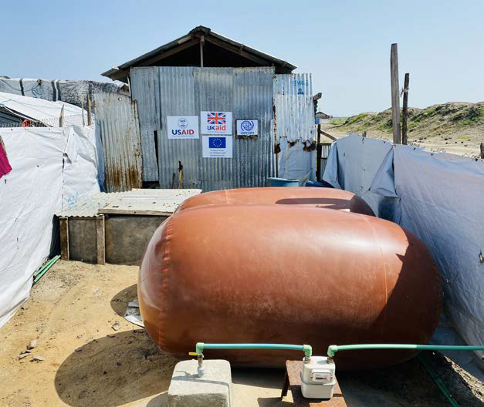
Case Study 1 - Producing Energy with a Bio-Digester System
Context: Malakal Protection of Civilians Site, South Sudan.
Environmental Challenge: Managing faecal sludge and providing energy in IDP camps while preventing environmental contamination.
Humanitarian Response:
    IOM installed an anaerobic bio-digester to treat faecal sludge and produce biogas for cooking and lighting.
    Reduced GHG emissions from sludge and firewood consumption.
    Lessons Learned:
    Reduced GHG emissions by 67%, saved 9.4-11.4 tonnes of firewood annually.
    Required technical expertise and community sensitization for sustainability.
    Demonstrated the importance of capacity building and comprehensive maintenance plans.
Source: DG ECHO/IOM

Slide 27
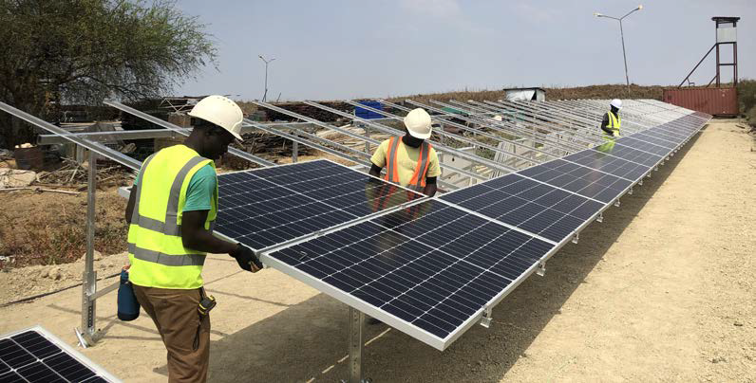
Source: DG ECHO/IOM
  Context: Malakal Humanitarian Hub, South Sudan.
  Environmental Challenge: High energy costs and carbon footprint from diesel generators in remote, insecure areas.
  Humanitarian Response:
        IOM transitioned the hub to solar energy, covering 80% of energy needs with solar PV and battery storage.
        Reduced reliance on diesel generators, saving €300,000 over 5 years and cutting CO2 emissions by 744 tonnes/year.
  Lessons Learned:
        Requires significant initial investment and technical expertise.
        Key challenges: securing capital, managing battery recycling.
      Emphasized multi-departmental collaboration for success.
Case Study 2 - Solarizing a Humanitarian Hub
Notes:
27

Slide 28
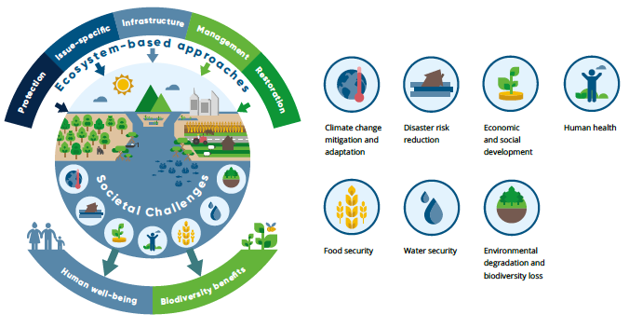
Case Study 3 - Nature-Based Solutions for Climate Resilience
  Context: Various humanitarian settings, including protracted crises and refugee settlements.
  Environmental Challenge: Rising disaster risks from climate change and environmental degradation.
  Humanitarian Response:
      A coalition of experts implemented nature-based solutions (NbS), such as ecosystem restoration, agroforestry, and sustainable land management.
      NbS provide disaster resilience and sustainable solutions that address both immediate and long-term humanitarian needs.
  Lessons Learned:
      NbS reduce vulnerabilities by leveraging ecosystem services like flood control.
      Require cross-sectoral collaboration and community-led, culturally appropriate solutions.
      Challenges: securing funding and technical expertise, ensuring inclusive, gender-responsive approaches.

Slide 29
Key Takeaways
Managing greenhouse gas emissions minimizes environmental impact and reduces operational costs, supporting long-term resilience.
Emissions from fuel use (Scope 1), electricity (Scope 2), and supply chain (Scope 3) contribute to climate change and impact vulnerable communities.
Energy-efficient technologies, optimized transportation, and green building practices are key strategies for reducing emissions.
Renewable energy sources like solar and wind power provide sustainable alternatives to fossil fuels in crisis settings.
Sustainable energy management aligns humanitarian operations with global goals such as the Paris Agreement and SDGs.
Case studies like Malakal Humanitarian Hub and bio-digesters in South Sudan demonstrate successful emission reduction.
Adopting green practices helps humanitarian operations balance efficiency with environmental sustainability.
Engaging local communities in energy management builds ownership, enhances maintenance, and fosters resilience.
Challenges in funding, technical expertise, and maintenance can be addressed through collaboration and innovative solutions.

Slide 30
Thank you
Any Questions?

