Slide 1



ENVIRONMENT IN HUMANITARIAN ACTION (EHA) TRAINING
Module 9:
Cross-Sectoral Collaboration and Knowledge Sharing
Name of Facilitator:
Venue:
Date:

Slide 2

Module Outline
0
1
0
2
0
3
0
4
Introduction to cross-sectoral collaboration
Interactive tools and simulations
Methods for effective knowledge sharing and collaboration
Case studies and best practices
Notes:
2

Slide 3

0
1
Module Learning Outcomes

Slide 4
By the end of this module, you should be able to:
Understand foundational concepts of environmental considerations in humanitarian action.
Integrate key humanitarian standards and principles into environmental considerations.
Articulate the importance of environmental sustainability in humanitarian contexts.
Identify and access resources and tools offered by the OCHA/UNEP Joint Environment Unit to enhance environmental integration.
Apply insights from case studies and best practices to improve the environmental sustainability of humanitarian operations.
Notes:
4

Slide 5

0
2
Session 1: Introduction to cross-sectoral collaboration

Slide 6
  Collaboration across sectors leads to more comprehensive, sustainable solutions in humanitarian contexts.
  Cross-sectoral collaboration involves cooperation between humanitarian, development, and environmental sectors to address complex crises, pooling resources, sharing expertise, and coordinating efforts for effective and resilient interventions.
  Environmental mainstreaming ensures environmental considerations are integrated across all stages of humanitarian action, improving sustainability and resilience.
  Challenges in cross-sectoral collaboration include systemic, operational, and contextual issues like differing priorities, funding mechanisms, and communication barriers.
Introduction

Slide 7
Benefits of Cross-Sectoral Collaboration
Resource Pooling: Combining resources for enhanced capacity (e.g., joint funding for humanitarian-environmental projects).
Shared Expertise: Leveraging knowledge across sectors for innovative solutions (e.g., collaboration for sustainable WASH programs).
Enhanced Efficiency: Streamlining operations to reduce redundancy.
Comprehensive Solutions: Addressing multiple dimensions of crises through joint strategies.
Improved Resilience: Building community resilience by tackling root causes of vulnerability.
Increased Innovation: Encouraging creative problem-solving.
Strengthened Advocacy: Amplifying advocacy through joint campaigns.

Slide 8
Challenges in Cross-Sectoral Collaboration:
Systemic Challenges
Differing Principles:
  Sectors like humanitarian, environmental, and development may operate with different core principles, such as neutrality, climate justice, or sustainability.
  Solution: Create shared frameworks that respect each sector’s principles while identifying common goals.
  Example: Balancing humanitarian urgency with long-term environmental goals in refugee camp planning.
Differing Priorities:
  Sectors often have different primary goals, leading to conflicts and compromises.
  Solution: Develop a common understanding of goals and find overlapping objectives. Regular dialogue can help align priorities.
  Example: Establishing frameworks for inter-sectoral communication between humanitarian and environmental actors.

Slide 9
Challenges in Cross-Sectoral Collaboration:
Systemic Challenges
Institutional Inertia:
  Resistance to change within organizations can impede cross-sectoral collaboration.
  Solution: Foster a culture of collaboration through leadership commitment and change management strategies.
  Example: Implementing change management strategies to promote collaboration across humanitarian and environmental organizations.
Funding Mechanisms:
  Securing funding that aligns with the objectives of multiple sectors can be difficult due to different priorities and funding cycles.
  Solution: Design integrated funding proposals highlighting mutual benefits. Engage donors who support multi-sectoral approaches.
  Example: Joint proposals for environmental and humanitarian donors to fund sustainable interventions.

Slide 10
Challenges in Cross-Sectoral Collaboration:
Systemic Challenges
Accountability and Governance:
  Establishing clear accountability and governance structures across sectors is complex, especially when multiple stakeholders are involved.
  Solution: Develop multi-stakeholder governance frameworks to promote transparency and shared accountability.
  Example: Creating governance frameworks involving governments, UN agencies, and other stakeholders.

Slide 11



Challenges in Cross-Sectoral Collaboration:
Operational Challenges
Coordination Complexity: Managing logistics across sectors requires robust coordination mechanisms.
  Communication Barriers:
    Differences in terminology, goals, and procedures can hinder effective communication.
  Solution:
    Standardize communication protocols and provide cross-sector training.
  Example:
    Joint workshops to align sectoral terminology and goals.
Solution: Establish clear roles and responsibilities and use coordination platforms.
Example: Joint operational plans ensuring aligned activities and timelines.

Slide 12
Challenges in Cross-Sectoral Collaboration:
Capacity and Training:
Different sectors may lack the skills to collaborate effectively.
    Solution: Implement cross-sectoral training programs and provide capacity-building resources.
    Example: Joint training for humanitarian, environmental, and development professionals.
Operational Constraints in Fragile Contexts:
Security risks and weak governance complicate collaboration.
    Solution: Adapt strategies for specific contexts and develop contingency plans.
    Example: Tailoring collaboration approaches to conflict zones with a focus on security and access.
Communication Barriers:
Differences in terminology, goals, and procedures can hinder effective communication.
    Solution: Standardize communication protocols and provide cross-sector training.
    Example: Joint workshops to align sectoral terminology and goals.
Cultural and Political Sensitivities:
Local dynamics can impact collaboration, particularly in politically or culturally sensitive areas.
    Solution: Engage local stakeholders early and conduct cultural/political assessments.
    Example: Designing culturally sensitive interventions that gain support from local communities.

Slide 13
Cross-Cluster Collaboration for Environmental Mainstreaming
Joint Needs Assessment:
Integrating environmental criteria in multi-cluster assessments (e.g., Shelter, WASH, Health).
Integrated Project Design:
Developing projects that address environmental concerns across clusters (e.g., water-saving technologies).
Shared Resources and Expertise:
Pooling resources across clusters for environmental solutions.
Collaborative Implementation:
Coordinating cross-cluster projects for integrated solutions (e.g., waste management).
Monitoring and Evaluation:
Jointly tracking the environmental impact of interventions.
Policy Development and Advocacy:
Promoting environmental sustainability in humanitarian policies.
Capacity Building:
Cross-sector training on environmental mainstreaming.

Slide 14

0
3
Session 2: Methods for effective knowledge sharing and collaboration

Slide 15



Introduction
Effective knowledge sharing enhances the capacity of organizations to address environmental issues in humanitarian contexts.
Platforms and tools can facilitate the dissemination of best practices and lessons learned.
Collaboration across sectors ensures that diverse expertise and resources are leveraged to develop comprehensive and sustainable solutions.

Slide 16
Methods for Effective Knowledge Sharing
Building partnerships: Formal and informal collaboration enhances resource pooling and expertise sharing.
Example: Memorandums of Understanding (MoUs) between organizations for joint initiatives.
Knowledge dissemination platforms: Tools for sharing information, best practices, and innovative solutions.
Example: Platforms like ReliefWeb, EHAN, ADAPT, ALNAP, and webinars.
Training and workshops: Events for capacity building and promoting best practices.
Example: Training platforms like RedR UK, DisasterReady, UNDRR.
Research and publications: Sharing evidence-based reports and insights for decision-making.
Example: Peer-reviewed journals, white papers, and case studies.
Community of practice: Networks for continuous learning and peer support.
Example: Professional networks, online forums.
Mentorship programs: Knowledge transfer through experienced professionals mentoring others.
Example: Formal mentorship schemes within and across organizations.
Notes:
16

Slide 17
Methods for Cross-Sectoral Collaboration
Integrated Planning: Joint planning sessions to align strategies across sectors.
Example: Multi-sectoral planning workshops.
Cross-Sectoral Committees: Committees with representatives from different sectors for coordinated action.
Example: Environmental committees in humanitarian organizations.
Joint Funding Mechanisms: Pooling resources from different sectors to increase financial capacity.
Example: Joint grant applications or pooled funding proposals.
Collaborative Implementation: Coordinating project implementation across sectors for efficiency.
Example: Integrated project teams for environmental and humanitarian interventions.
Shared monitoring and evaluation (M&E): Developing joint M&E frameworks to track impact.
Example: Joint progress reports and environmental impact assessments.
Regular coordination meetings: Regular meetings to discuss challenges and maintain collaboration.
Example: Monthly inter-agency working group meetings.
Policy development and advocacy: Jointly advocating for environmental and cross-sectoral policies.
Example: Co-authored policy briefs and advocacy campaigns.

Slide 18
Entry Points for Collaboration and Knowledge Sharing
Needs assessments: Including environmental criteria in assessments.
    Example: Adding environmental impact questions to surveys.
Project design and planning: Co-designing projects from the initial stages.
    Example: Jointly planned projects with environmental and humanitarian experts.
Implementation phases: Coordinating field activities across sectors.
    Example: Scheduling joint missions and sharing resources.
Monitoring and evaluation: Developing shared frameworks and indicators.
    Example: Collaborative impact assessments.
Policy development: Creating policies that require cross-sector collaboration.
    Example: Drafting environmental policies with input from various sectors.
Funding proposals: Including collaboration requirements in grant applications.
    Example: Donor requirements for integrated project proposals.
Training and capacity building: Offering joint training and workshops.
    Example: Workshops with different sector professionals.
Knowledge management systems: Repositories for sharing knowledge and best practices.
    Example: Online platforms for sharing case studies.
Advisory boards and committees: Boards with cross-sector representation.
    Example: Advisory committees with environmental and humanitarian experts.

Slide 19
Enablers for Effective Collaboration
Strong leadership commitment: Leadership advocating for integrated approaches.
Example: Senior management support for cross-sector initiatives.
Stakeholder engagement: Including all relevant stakeholders in planning and decision-making.
Example: Participatory planning with community members and sector representatives.
Adequate funding and resources: Ensuring sufficient resources for collaboration.
Example: Budgets allocated for joint projects.

Slide 20
Enablers for Effective Collaboration
Capacity building: Training staff to collaborate and share knowledge effectively.
Example: Workshops on cross-sectoral collaboration.
Effective communication: Clear communication channels to ensure efficiency.
Example: Regular meetings and updates between sector representatives.
Technology and innovation: Leveraging technology for better collaboration.
Example: Collaborative platforms and software for shared projects.

Slide 21

0
4
Session 3: Interactive tools and simulations

Slide 22
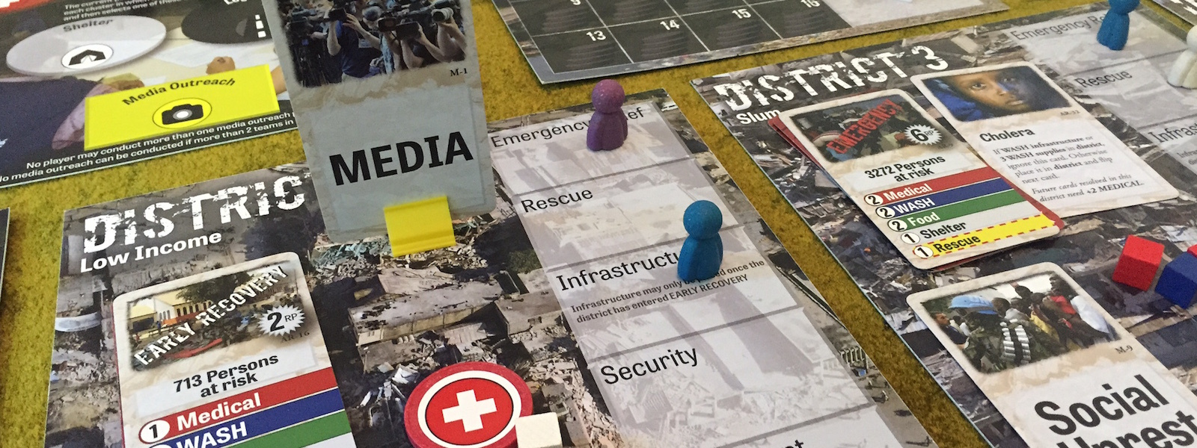
  AFTERSHOCK game simulates the complexities of interagency cooperation during a humanitarian crisis, with a strong focus on environmental challenges.
  Interactive simulations provide participants with hands-on experiences to practice decision-making and problem-solving in realistic crisis scenarios, incorporating environmental considerations.
  These tools emphasize the importance of cross-sectoral collaboration, showing how environmental factors impact humanitarian action and decision-making processes.
  Using simulations helps participants gain a deeper understanding of the consequences of their decisions, especially in relation to resource management, environmental sustainability, and effective crisis response.
  Simulations and role-playing activities foster real-time interaction and help participants navigate the complexities of humanitarian action while addressing environmental impacts.
  These exercises serve as practical training for humanitarian professionals, preparing them to manage environmental risks and incorporate sustainable practices into their operations.
Introduction

Slide 23

AFTERSHOCK Game
  Objective: Simulate interagency cooperation and decision-making in a humanitarian crisis, integrating environmental considerations.
  How it works: Participants assume different roles and collaborate to manage resources, respond to emergencies, and solve environmental challenges.
    Refer to the instructions in the game package
  Time: 90 minutes to 2 hours.
  Facilitator & Participants: A game master guides the session, and participants engage in decision-making.
  Outcomes: Enhanced understanding of resource management, collaboration, and decision-making, with a focus on environmental sustainability.

Slide 24
Alternative Tools and Simulations
Role-playing activities:
  Objective: Develop negotiation, communication, and crisis management skills while addressing environmental impacts.
  Execution: Participants assume various roles, interact, and negotiate to resolve crisis situations.
  Outcomes: Enhanced collaboration and negotiation skills, with a focus on environmental sustainability.
Scenario-based exercises:
  Objective: Simulate evolving, multi-sectoral humanitarian scenarios with an environmental focus.
  Execution: Participants work on real-time challenges, making decisions that integrate environmental considerations.
  Outcomes: Improved problem-solving, adaptive thinking, and cross-cluster coordination.

Slide 25
Alternative Tools and Simulations
Field exercises:
  Objective: Apply theoretical knowledge in a real-world setting, considering environmental impacts.
  Execution: Mock drills and scenarios in controlled environments allow participants to practice disaster response.
  Outcomes: Practical experience in disaster response, improved readiness, and application of environmental best practices.
Simulation software (e.g., Simul8):
  Objective: Analyze participant decisions in virtual crisis scenarios with environmental data integration.
  Execution: Participants make decisions using the software and observe feedback on their impact.
  Outcomes: Detailed insights into decision impacts, improved strategic planning, and better integration of environmental data.

Slide 26
Alternative Tools and Simulations
Virtual simulations:
  Objective: Simulate real-world humanitarian scenarios in a virtual environment, focusing on environmental integration.
  Execution: Participants interact with a virtual scenario, making decisions in real-time.
  Outcomes: Enhanced decision-making skills, collaboration, and understanding of environmental impacts in a virtual, risk-free environment.

Slide 27

0
5
Session 4: Case studies and best practices

Slide 28
  Cross-sectoral collaboration addresses complex environmental challenges in humanitarian settings.
  Partnerships between humanitarian organizations, environmental agencies, and local governments promote shared resources and expertise.
  Real-world case studies demonstrate how collaboration leads to sustainable practices and enhanced resilience.
  Collaborative efforts help address immediate humanitarian needs while promoting long-term environmental sustainability.

Slide 29

Source: JEU
  Context: Addressing the environmental impacts of packaging waste in humanitarian operations.
  Collaboration: 23 humanitarian actors, including UN agencies, NGOs, and donors.
  Outcome: Developed strategies for reducing packaging waste, promoted recycling practices, and created tools, guidelines, and webinars to share knowledge and experiences.
Joint Initiative on Sustainable Humanitarian Assistance Packaging Waste Management
Notes:
29

Slide 30

  Context: Humanitarian response to environmental emergencies.
  Collaboration: UNEP's technical expertise + OCHA's humanitarian network.
  Outcome: Over 200 missions mobilized, provided independent environmental advice, improved environmental sustainability in humanitarian operations.
UNEP/OCHA Joint Environment Unit (JEU)

Slide 31
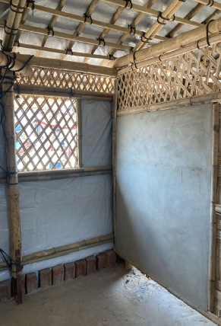
Cox’s Bazar, Bangladesh (Energy and Environment Technical Working Group)
  Context: Managing environmental impacts in Rohingya refugee camps.
  Collaboration: UN agencies, NGOs, Bangladesh government.
  Outcome: Implemented reforestation, sustainable construction, waste management programs, and introduced LPG fuel to reduce environmental damage and enhance resilience.
Source: InterAction
Notes:
31

Slide 32
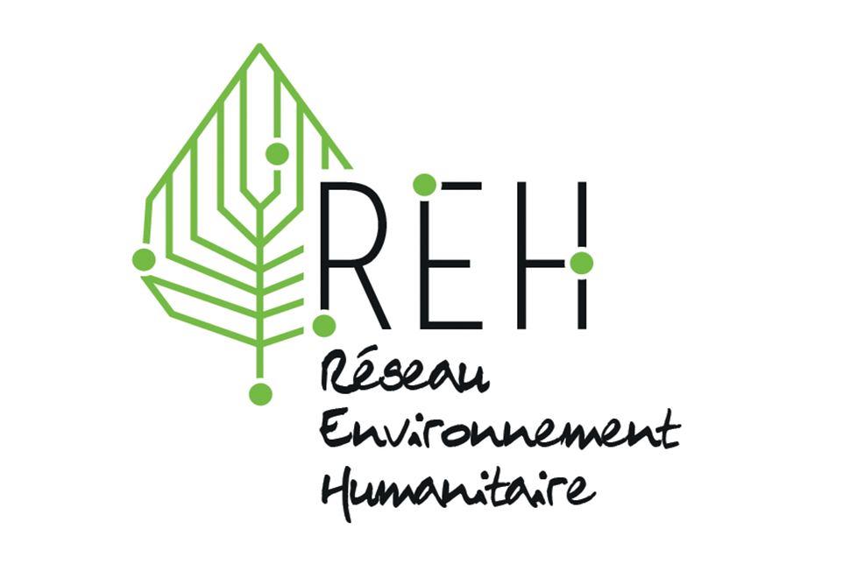
Humanitarian Environment Network
  Context: Integrating environmental approaches into humanitarian operations.
  Collaboration: Groupe URD, ACTED, Action contre la Faim, CARE, Médecins du Monde, and other partners.
  Outcome: Measured environmental impacts, promoted sustainable practices, and aimed to halve emissions by 2030.
Source: Groupe URD
Notes:
32

Slide 33

Global Shelter Cluster Environment Community of Practice (GSC ECoP)
  Context: Environmentally responsible rebuilding post-disaster.
  Collaboration: WWF, UNHCR, IFRC, DG-ECHO, USAID-BHA.
  Outcome: Provided technical support, policy advice, and tools for climate-informed humanitarian responses.
Source: Global Shelter Cluster
Notes:
33

Slide 34
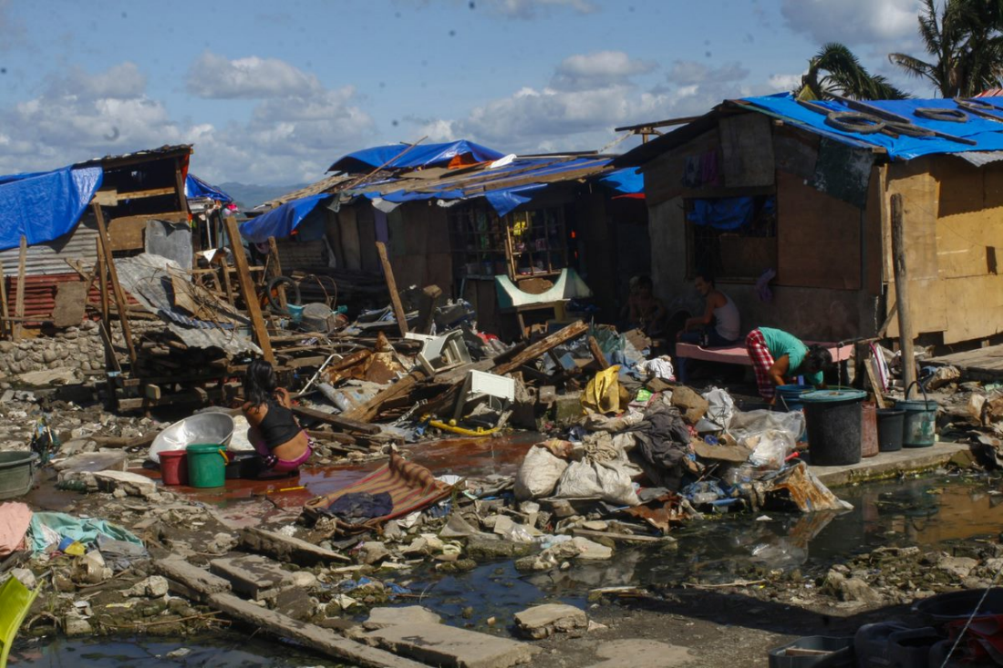
Source: Logistics Cluster
  Context: Reducing environmental impacts in humanitarian logistics.
  Collaboration: Global Logistics Cluster with Danish Refugee Council, IFRC, Save the Children, and WFP.
  Outcome: Implemented circular economy principles in logistics, focusing on sustainable procurement, waste management, and transportation.
WREC Project (Environmental Sustainability in Humanitarian Logistics)
Notes:
34

Slide 35

Source: UNDP/UNFCCC
  Context: Advocating for loss and damage finance for communities affected by climate change.
  Collaboration: 200+ humanitarian, climate, and development organizations led by CAN-I and ICVA.
  Outcome: Established the Loss and Damage Fund at COP27, focusing on supporting vulnerable communities with climate-induced challenges.
Joint Call for Action on Loss and Damage Fund
Notes:
35

Slide 36
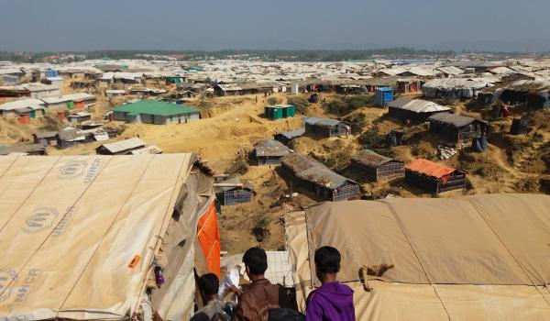
Source: IUCN
  Context: Addressing environmental impacts and human-wildlife conflicts in refugee camps in Cox’s Bazar, Bangladesh.
  Collaboration: UNHCR and IUCN.
  Outcome: Reduced human-wildlife conflicts, promoted reforestation, and environmental restoration, expanded globally through an MoU.
UNHCR and IUCN Partnership on Nature-based Solutions
Notes:
36

Slide 37
Key Takeaways
Cross-sectoral collaboration between humanitarian, development, and environmental sectors enhances crisis response sustainability and resilience.
Benefits include resource pooling, shared expertise, enhanced efficiency, innovation, and better decision-making.
Challenges include differing principles, funding mechanisms, communication barriers, and coordination complexity.
Cross-cluster collaboration effectively mainstreams environmental considerations through joint assessments, project design, and shared resources.
Effective knowledge sharing strategies include partnerships, knowledge platforms, training, and mentorship programs.
Entry points and enablers for collaboration include needs assessments, project design, strong leadership, and stakeholder engagement.
Interactive tools like the AFTERSHOCK game simulate crisis scenarios, improving decision-making and environmental integration skills.
Case studies highlight successful collaboration leading to innovative solutions and improved resilience in humanitarian contexts.
Applying cross-sectoral collaboration ensures environmental sustainability is prioritized in humanitarian responses.
Reflection on collaboration and knowledge sharing helps enhance environmental sustainability in diverse humanitarian contexts.

Slide 38
Thank you
Any Questions?

